Slide 1
Module 3 Hands-on Activities

Slide 2
Hands-on Activities
Upload “Output.csv” file from Module 2
Calculations activity
LOD activity
Parameter activity

Slide 3
Create Parameter
Directions Create Parameter & Calculated Field Filter for Fatalities, Total Victims, and Injured.
Click on square box with + to create a new sheet.
Click on left toolbar click the down arrow, choose create parameter.
Edit Parameter box will open.
Name Parameter: Chosen Stat.
Change data type to string and allowable values to List.
Click on values. Write:
Fatalities
Injured
Total Victims.
Click ok. The edit parameter box will close.
Click on down arrow on left toolbar, choose create calculated field.
Box opens for calculated field.
Name calculated field- Chosen Stat
Write: ﻿﻿CASE [Parameters].[Chosen Stat] WHEN "Fatalities" THEN [Fatalities] WHEN "Injured" THEN [Injured] ELSE [Total Victims] END
Hit ok. The calculated field is now dynamically linked to the parameter creating a filter.

Slide 4
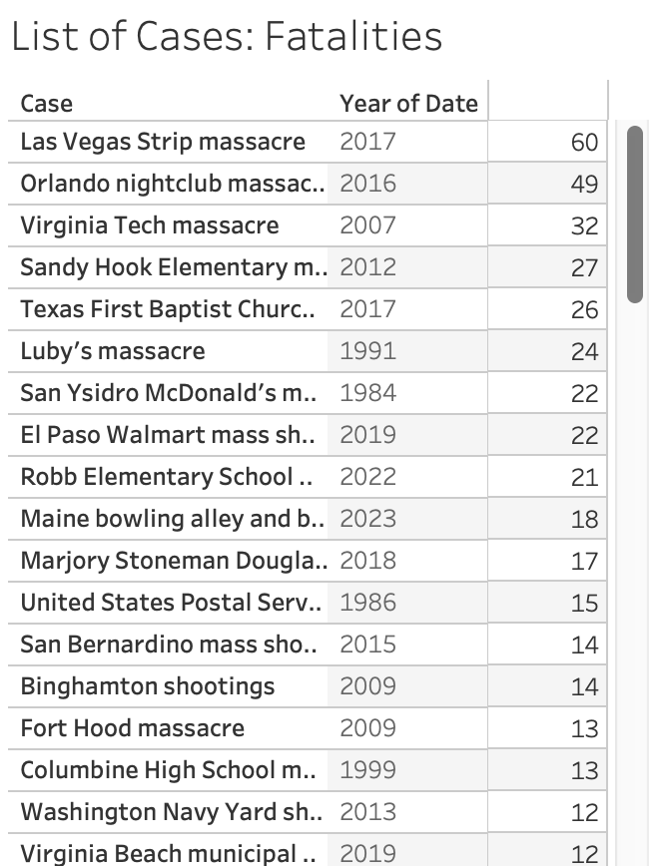
List of Cases by Chosen Stat. Table
Drop the Case field on to the rows shelf.
Drop the Date field onto the rows shelf.
Drop the Chosen Stat field onto the text mark.
Drop the Summary field onto the tooltip mark.
Drop Chosen Stat Parameter onto the detail mark
Click on the title box above the table and edit title.
Add a : after sheet name and insert Parameters.ChosenStat. This give you a dynamic title.
Click Analysis – Parameters – Chosen Stat.
The Chosen Stat filter now appears on the right pane.
Click it to change the values.

Slide 5
Basic Filtering
Filter the List of Cases table by a particular state
For example, this would be helpful if we wanted to filter the table to only view the data on mass shootings in the state of Ohio.

Slide 6
Statistics By Setting
Create a new sheet and name it By Venue.
Drop Location 1 on to the Columns Shelf
Drop Case onto the Rows shelf.
Click the down arrow on the Case pill.
Select Measure Count Distinct. Notice this turns the measure into a metric.
Drop Case on to the label mark.
Change Case to Measure Count Distinct.
Now sort the data using the sort icons on the toolbar header from most to least.
Change the color to grey.

Slide 7
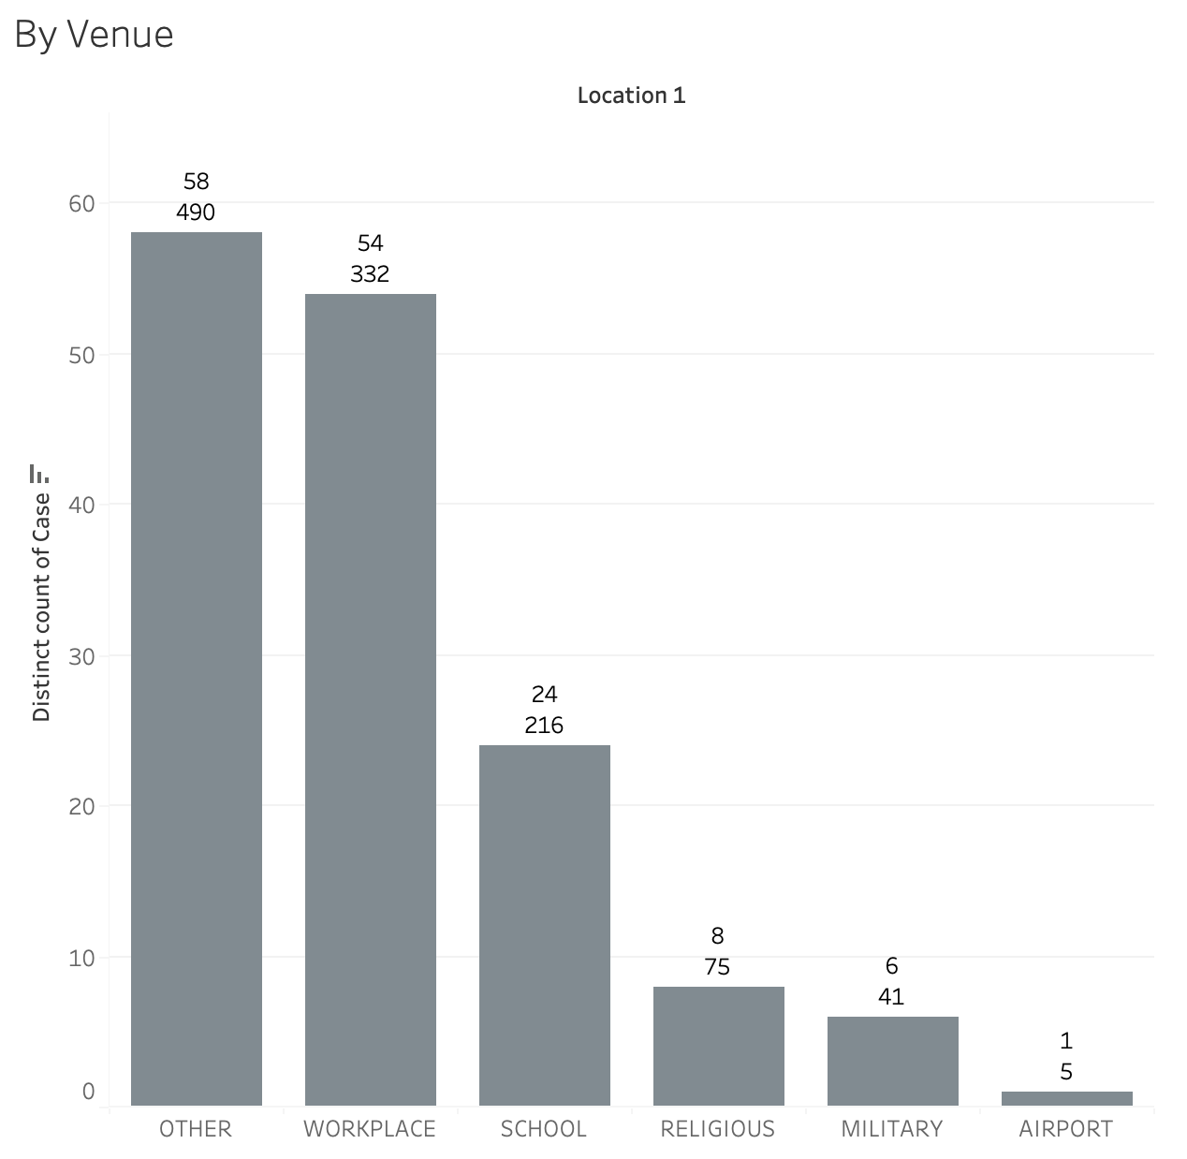
Level of Detail
Create a calculated field to create a Level of Detail expression
Label the LOD expression “LOD fatalities”
We want to calculate the total number of fatalities for each location on our bar plot
Formula: {FIXED [Location 1]: SUM([Fatalities])}
Drag the LOD expression to label

Slide 8
Save Tableau workbook as .tbwx for Module 4

Slide 9
Resources
Getting Started with Calculations in Tableau PDF
Parameters
https://help.tableau.com/current/pro/desktop/en-us/parameters_create.htm
LOD
https://help.tableau.com/current/pro/desktop/en-us/calculations_calculatedfields_lod.htm
Calculations
https://help.tableau.com/current/pro/desktop/en-us/calculations_calculatedfields_create.htm
Filtering
https://help.tableau.com/current/reader/desktop/en-us/reader_filter.htm
Aggregations
https://help.tableau.com/current/pro/desktop/en-us/calculations_aggregation.htm

Slide 10
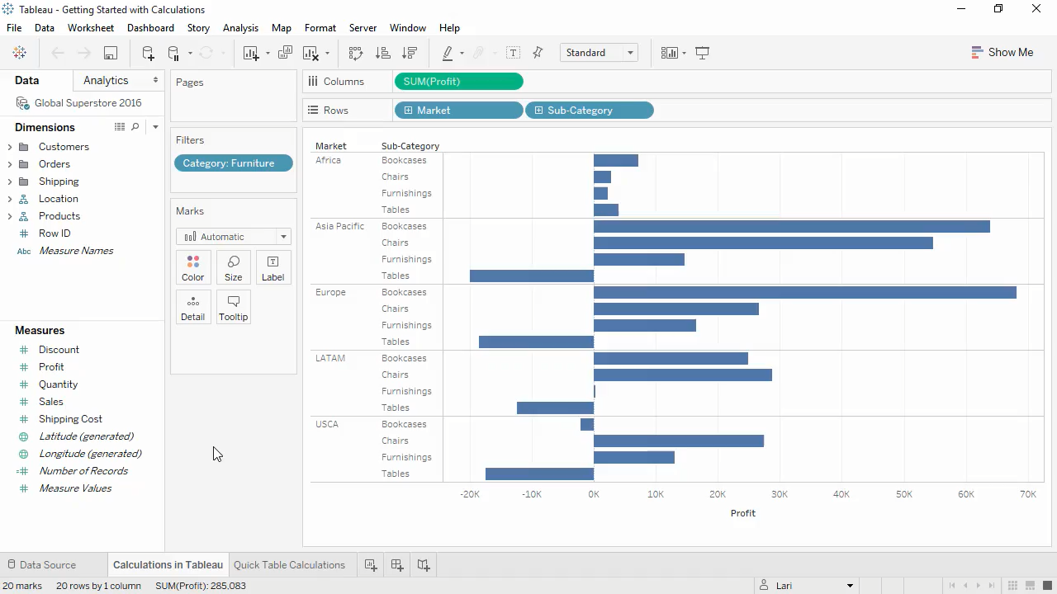
Calculations⁵
Calculated field
If else statement
Table calculations

